Slide 1
Medical Business WaitTime Tracker through AI
Team Members : KBMK Kangunati Venkatkiran Manvitha Baireddy Marru Saideep Kollu Gopi

Slide 2
Key Features
Target Market : The Main Target for our project is Business Owners and General Public
Key Features:
AI Live Video Processing
Accuracy
Open Source
Dashboard
Data Privacy

Slide 3
Main Modules in this project
Human Detection and Count.
Wait Time Analysis
Database
Web Page (To display current stats)

Slide 4

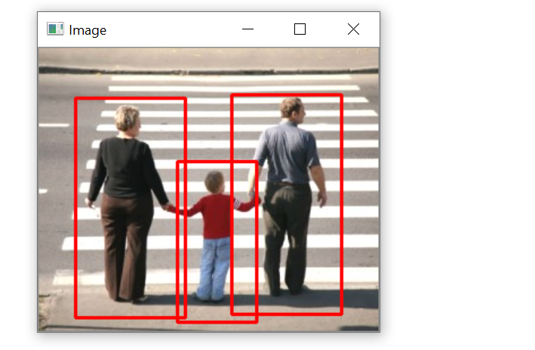
Human Detection from live video
There are a variety of computer applications that identify human body in digital images, like - pedestrian crossing, criminal identification, healthcare and so on. The detection program allows us to identify and locate objects. It is very important in area of research, where the detected object can be count, accurately determined.

Slide 5
Human Detection from live video
Human detection & counting using OpenCV in Python is used for standard image processing functions, along with the deep learning object detector elements to analyze the number of people in a given area.
Object detector elements used
Histogram of oriented gradients (HOG)
Support vector machines (SVM)
Non-Maximum Suppression (NMS))

Slide 6
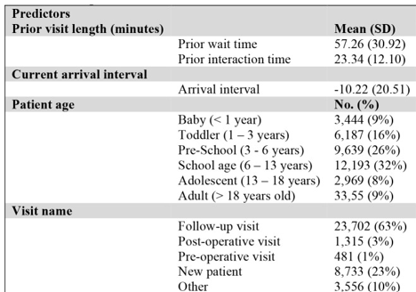
Wait Time Analysis
Machine Learning methods used for wait time analysis on previous data:
Pre-processing stages performed on data
Data Preparation
Data Preprocessing/ Cleaning
Data transformation and dimensionality reduction

Slide 7
Wait Time Analysis
Processing stages to identify long wait time and normal wait time
Four classification models, including random forest, elastic net with logistic regression, GBM, and SVM, were developed to determine “long wait time” or “normal wait time”.

Slide 8
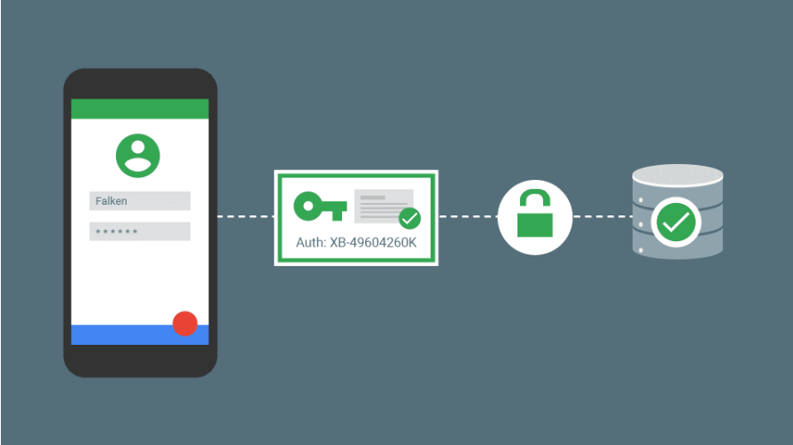

Database
Using Google Firebase for backend.
Advantages:
Real Time Database
Firebase ML
User Authentication
Cloud Storage

Slide 9

Web page
Web Page is used to authenticate the user and display the stats related to current wait time in the store. Web Page is developed using:
HTML
CSS
JavaScript
Firebase

Slide 10
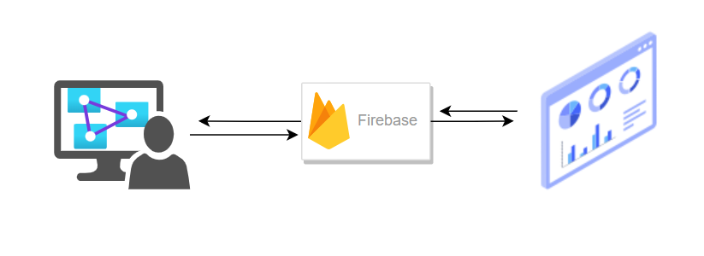
Conclusion
To Conclude the data flow for the above mentioned modules are
Human Count and Wait Time analysis are processed in local machine (Due to camera module limitation, we are using laptop webcam for Human detection).
Processed data will be stored in Firebase.
Web Page displays the real time information from firebase

Slide 11
Plan for Implementation Phase
Nov 1st week: we will be working on AI live video processing and how to detect human.
Nov 2nd week: Based on the detected number of people we will work on how to allocate the wait time and storage of data in database.
Nov 3rd week: we will be working on designing the web page.
Nov 4th week: This week we will test the project whether it is giving the correct output or not. If there is any minor errors we will work to rectify that errors.

Slide 12
Github Link
https://github.com/KKMBTeam/waittime-tracker

